Slide 1

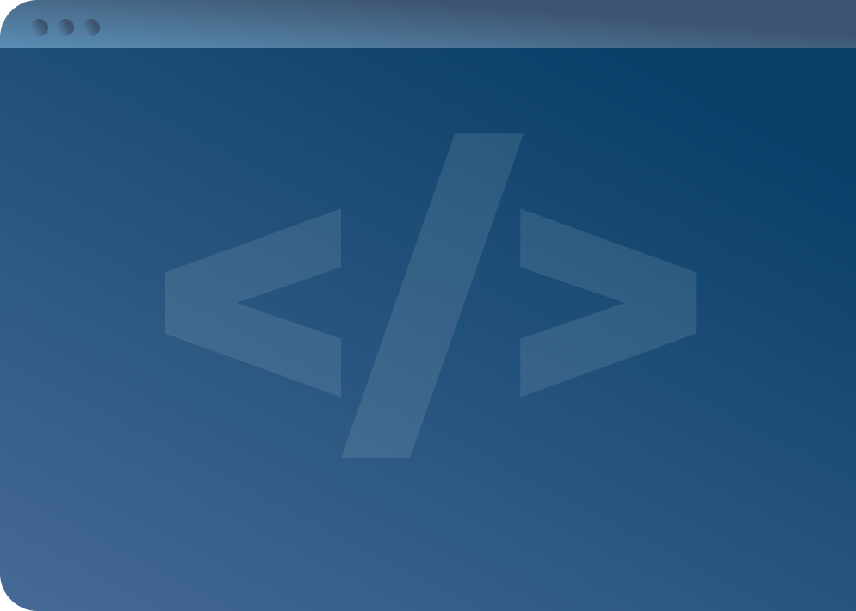

SOFTWARE DEVELOPMENT PROFESSIONAL PROGRAM
Version Control with Git

Slide 2





Version Control with Git
Learning Objectives
Know the difference between Git and GitHub.
Use Git commands to track your work and contribute to a project.
Publish websites on GitHub Pages.

Slide 3
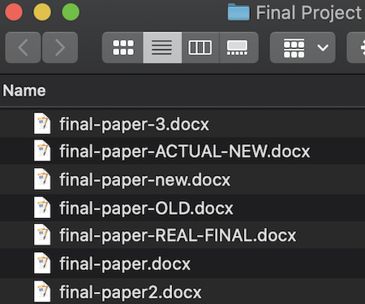
Version Control with Git
Version Control
Picture this:
You've got a final project due!
Does this look familiar?
Notes:
We've all had problems like this! We were trying several different approaches and sometimes needed to
go back and refactor older versions of work. This is one of the problems version control helps solve!

Slide 4

Version Control with Git
Version Control Benefits
Previous saved versions exist in our history!
Git organizes all of our work into a single project.
We can restore the "old" work as needed.
Notes:
Git is extremely important and useful to developers. It allows you to collaborate with others on code,
without having to worry about any mistakes breaking your project. Also, Git makes it very easy to go
back and revisit earlier work, as well as creating a space where you can access your code from anywhere.

Slide 5

Version Control with Git
Version Control Benefits
Collaboration with a team
Restoring previous work
Centralizing progress tracking
Merging separate work together

Slide 6


Version Control with Git
Introducing Git
Git is the most popular version control tool.
Created by Linus Torvalds
Logo downloaded from Git-SCM.com.
Notes:
Anyone recall anything else Linus Torvalds may be known for?
<< Refer to LC exercise 1: What is Git? >>

Slide 7
Version Control with Git
Git Repositories
Git stores your project files in repositories.
Git tracks changes that take place inside your repository.

Slide 8

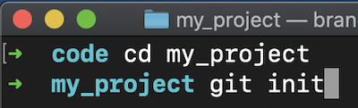
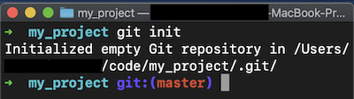
Version Control with Git
Making a Repo
Git is a tool on your command line.
Afterward, the repository is initialized.
At project location, run git init
Notes:
Once a repository is initialized, Git "watches" all changes that take place. Remind students to
make sure they init at the root of their project and not their root directory!

Slide 9



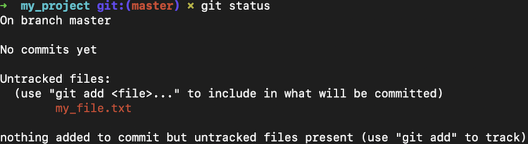
Version Control with Git
Git Status

Slide 10


Version Control with Git
How Git Add Works
You'd pack it into a box:
Imagine you want to mail a gift.
Creative commons license: Pixabay
Notes:
Let's say you'd like to mail a package to your Aunt Sally. In our example, when we ADD gifts to
the box, this is like the "git add" command. When something is untracked, that means it's not in the box!

Slide 11

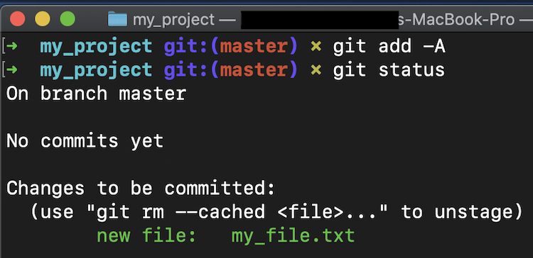
Version Control with Git
Git Add
Notes:
The -A indicates "all files" in the repository. You can also elect to add only certain files or folders.
In our gift-mailing analogy, this is the process where we decide what to put in the box.
<< Refer to LC exercise 2: How do you add all files with git add? >>

Slide 12

Version Control with Git
Git Commit
The next step is sealing the package!
You wouldn't mail an open box, right?
Creative commons license: Pixabay
Notes:
Once all the contents are safely inside, you seal it with packing tape.

Slide 13
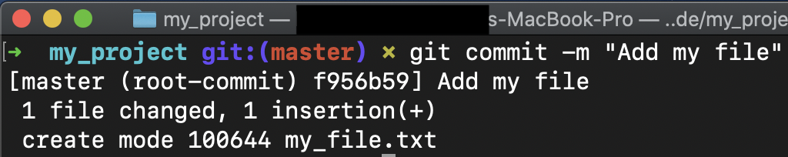
Version Control with Git
Git Commit
git commit wraps up all the changes you've added into a nice package.
Notes:
The "-m" means "message." We add a descriptive message to remind ourselves what we did at this
step of the process. It is important to make this a brief but meaningful message to summarize
the changes you have made. Remember to commit often!
<< Refer to LC exercises 3 and 4: Importance of adding commit messages. Which flag is used to add
a commit message? >>

Slide 14
Version Control with Git
Let's Discuss
So far, everything we've done is on our own machine.
We have a nice package ready to mail... What should we do next?
Notes:
The next step with our package is to address it with Aunt Sally's mailing address.
Then we hand the box over to the post office to send it on its way.

Slide 15

Version Control with Git
Git Remotes
Many people have mailboxes.
Each mailing address is unique, which ensures that your package can get to the right person!
Notes:
With Git, a "remote" is any address that you might send or receive code from. In the package-mailing
analogy, the "remote" is Aunt Sally's postal address. Many people have addresses, but only one
belongs to Sally!

Slide 16
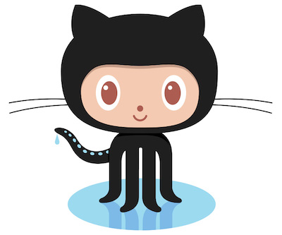

Version Control with Git
Introducing GitHub
GitHub is a social media site for your Git projects.
Octocat and GitHub logos are provided by GitHub and used legally as promotion of Octocat and GitHub.
Notes:
You've probably heard of GitHub. It's one possible "remote address" we would want to send our code to.
It's a very popular site.

Slide 17
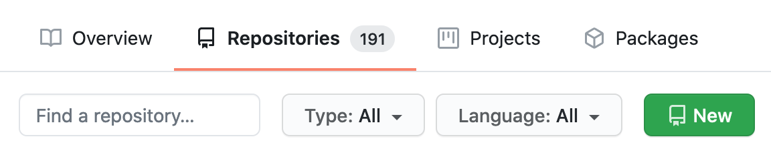
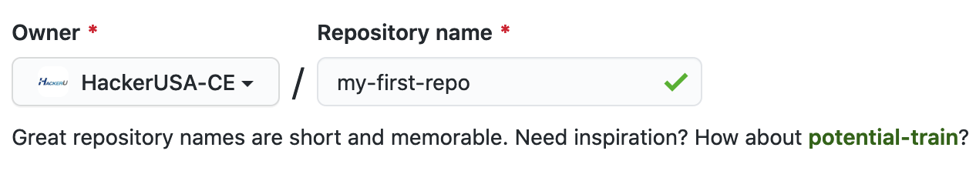
Version Control with Git
GitHub Repositories
GitHub repos can be created on your GitHub account.
Name your repo and click Create Repository.

Slide 18
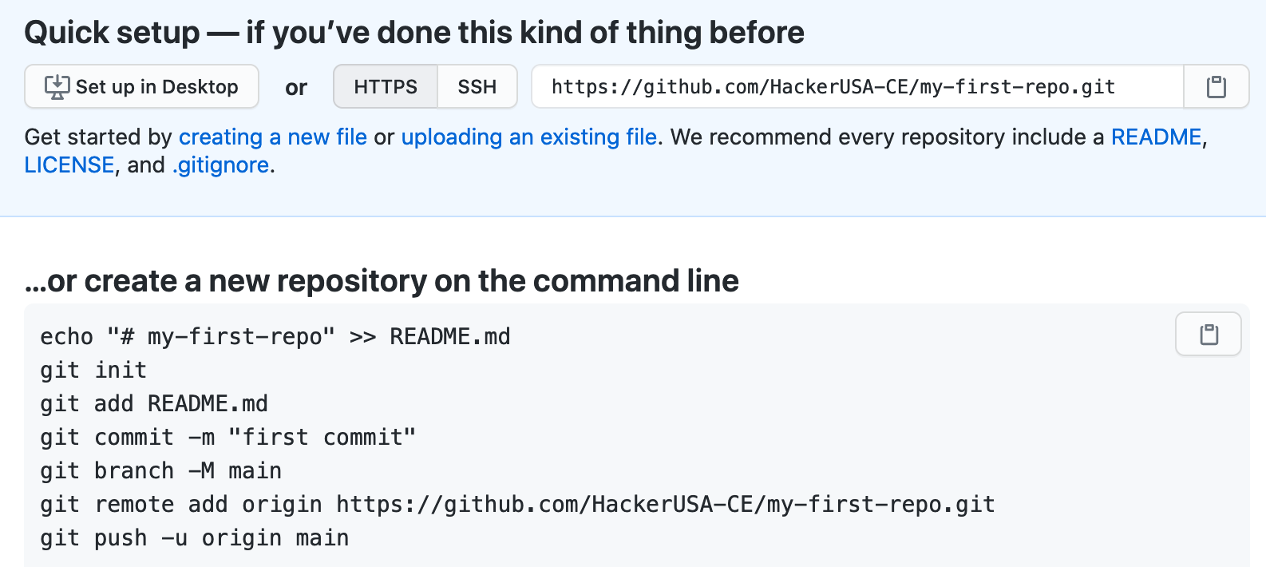
Version Control with Git
Git Remote Addresses
Notes:
GitHub offers the remote address as both an HTTPS and an SSH link. Copy the HTTPS link!

Slide 19
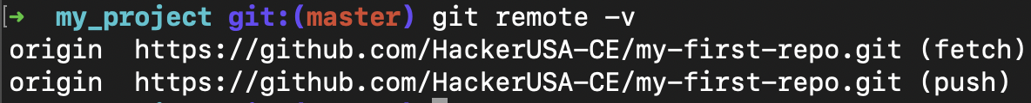
Version Control with Git
Git Remote Addresses
Origin refers to GitHub, in this case.
Notes:
This is adding a remote address for us to send code to. After we've added an address, we can list the
addresses with "git remote -v". "Fetch" means receiving and "push" means sending. Next, we'll want to "push"
our local code to GitHub.

Slide 20

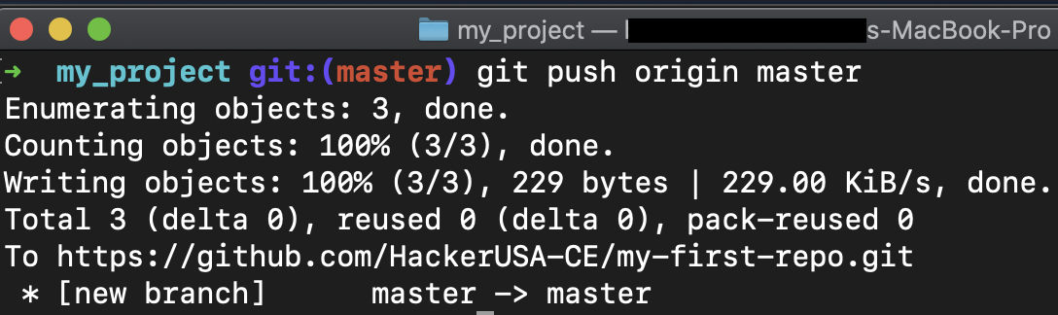
Version Control with Git
Git Push
Notes:
At some point in the package-mailing process, we physically send out the package.
We hand it over to the post office and trust they know where to send it based on the address.

Slide 21
Version Control with Git
Git Push Origin Main (or Master)?
Git: Our version control!
Push: Send outside of my machine.
Origin: Recipient address (GitHub, in this case)
Main or Master: Default branch (depends on how it's created!)
Notes:
This command is telling our machine to send our code to GitHub.
Branches are used for developing features and working on teams.
NOTE: "main" is now the default branch name on GitHub. This changed from "master" in 2020.
Git itself still uses "master" so when we create a repository with the terminal command
"git init", we will get a repository that uses "master" as the default branch.
<< Refer to LC exercise 5: Which command sends code to a repository? >>

Slide 22

Version Control with Git
Quiz: Multiple Choice
In our package-mailing analogy, which Git command represents taping up or sealing your box?
A. git add
B. git commit
C. git push

Slide 23
Version Control with Git
Quiz: Multiple Choice Answers
In our package-mailing analogy, which Git command represents taping up or sealing your box?
🚫 A. git add
✅ B. git commit
🚫 C. git push
Notes:
Committing your code is like sealing your package. Up until that point, you can
run "git add" as many times as needed.

Slide 24
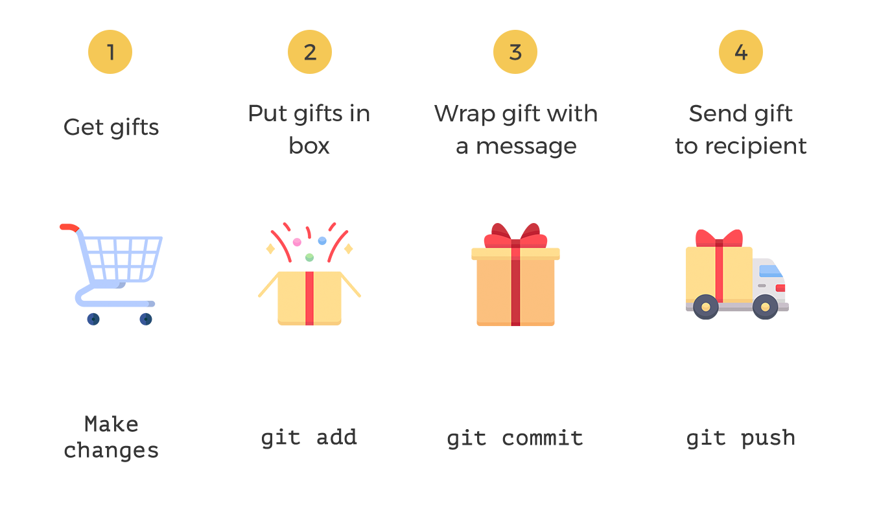
Version Control with Git
Summary
From: ThriveDX (Compiled June 15, 2022 with icons from Freepik)
Notes:
<< Summarize the gift giving analogy all together >>
<< Be sure to mention the "git remote"'s part in all of this, being the recipient's address in the analogy >>

Slide 25
Version Control with Git
Activity: Let's Practice!
Let's "Git" some practice!

